Slide 1
Lisa Vinebaum
Studio practice

Slide 2
Performance-based, self-portrait works.
(Life-sized images of approximately 8 x 5 feet when printed, also shown as large-scale, projected digital images.

Slide 3
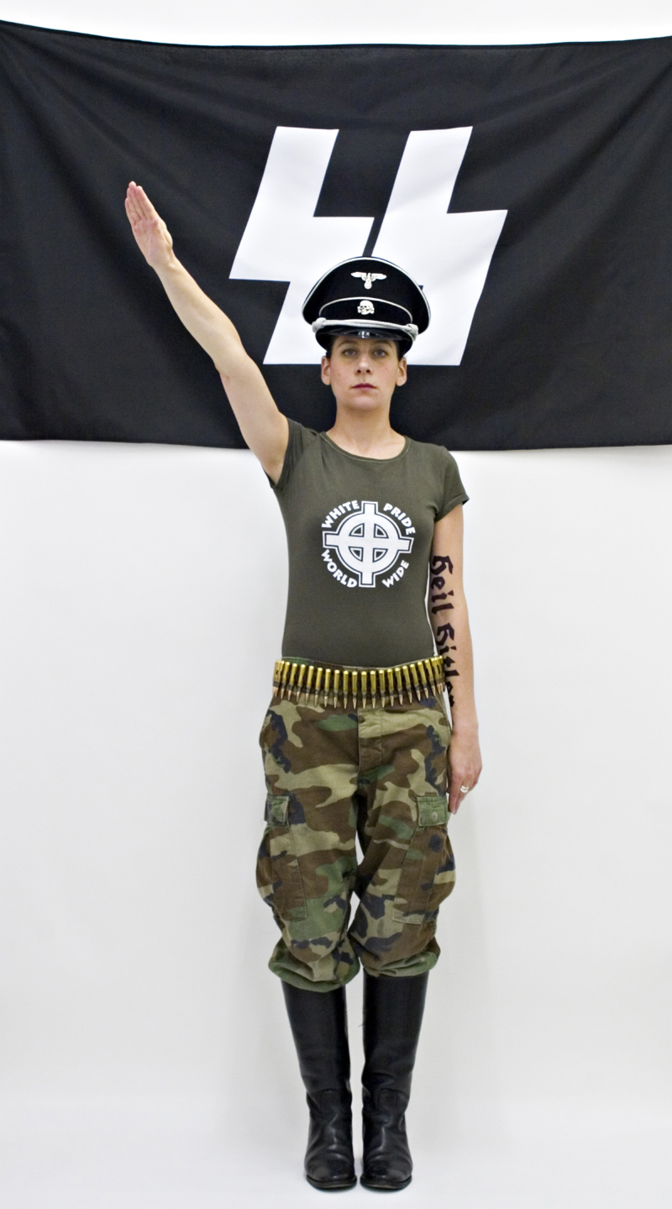
Self-portrait as a neo-Nazi (2004)
Performance-based, self-portrait image

Slide 4
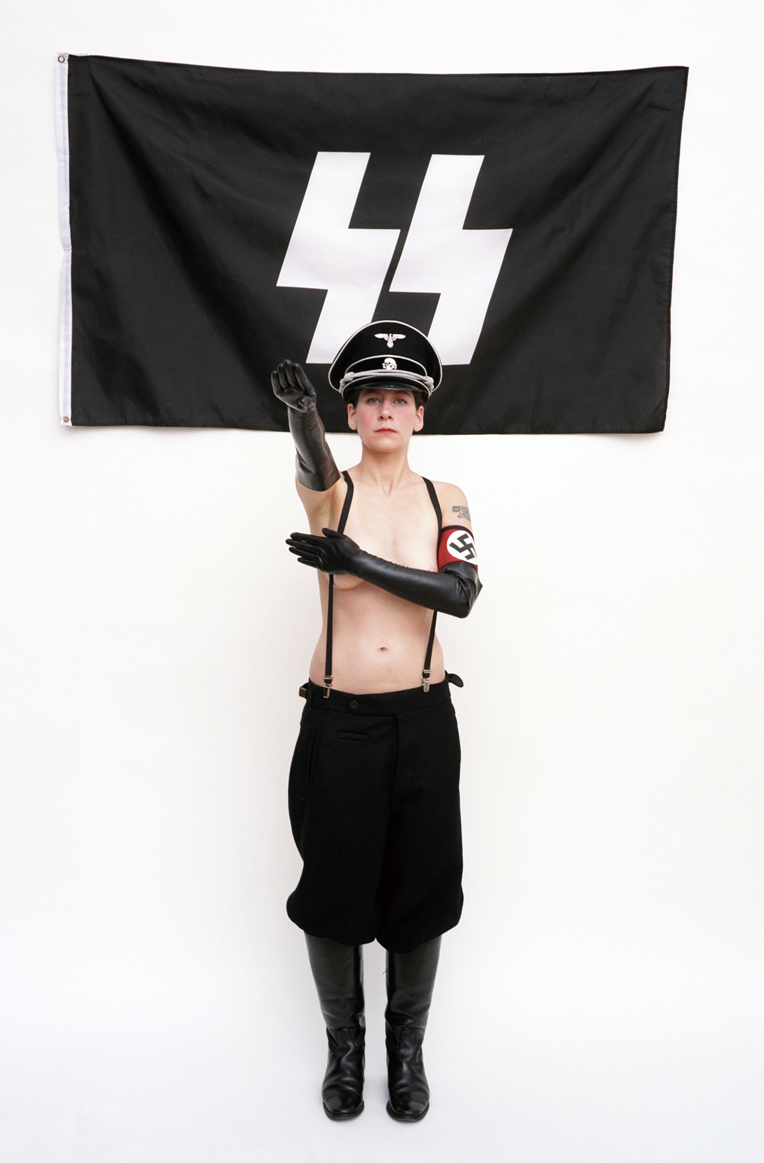
After Lucia (2006)
Performance-based, self-portrait image

Slide 5
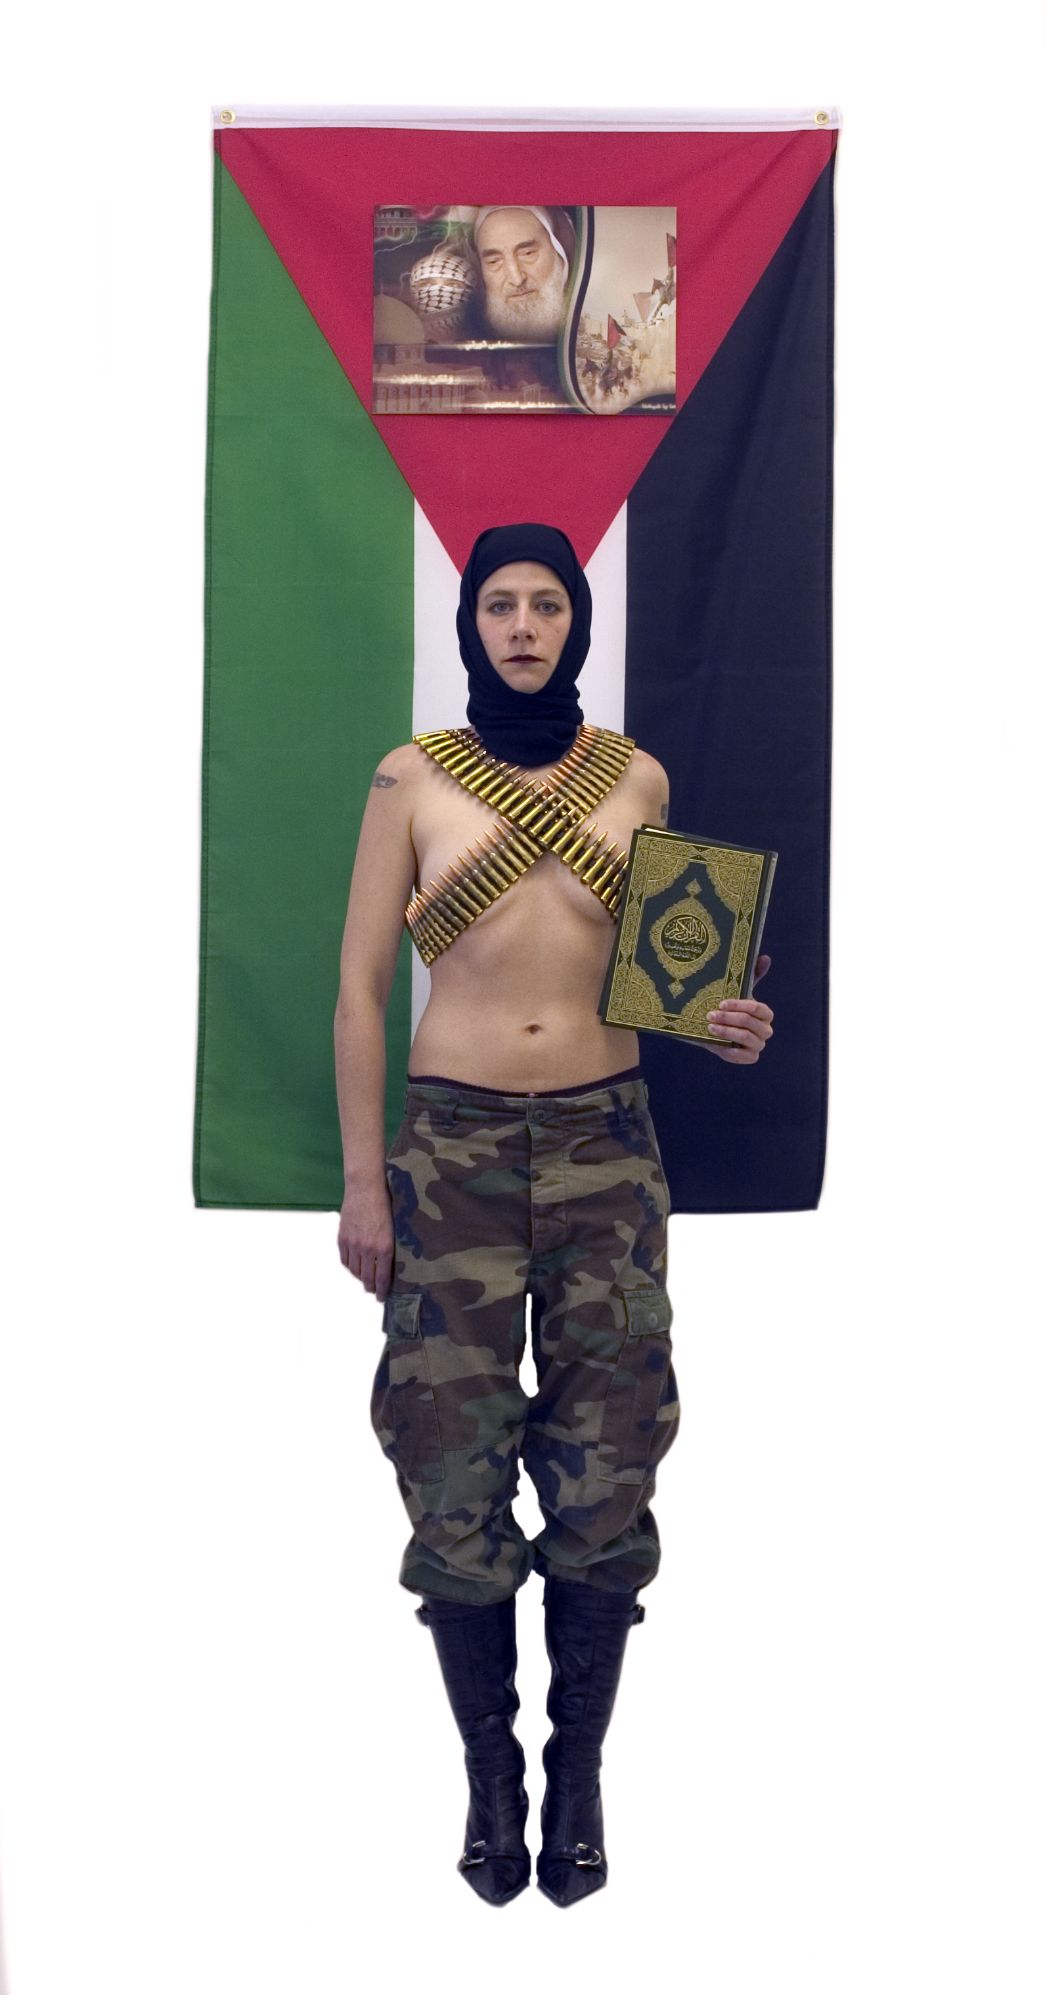
Self-portrait as a Palestinian martyr (You’ve come a long way baby) (2004)
Performance-based, self-portrait image

Slide 6
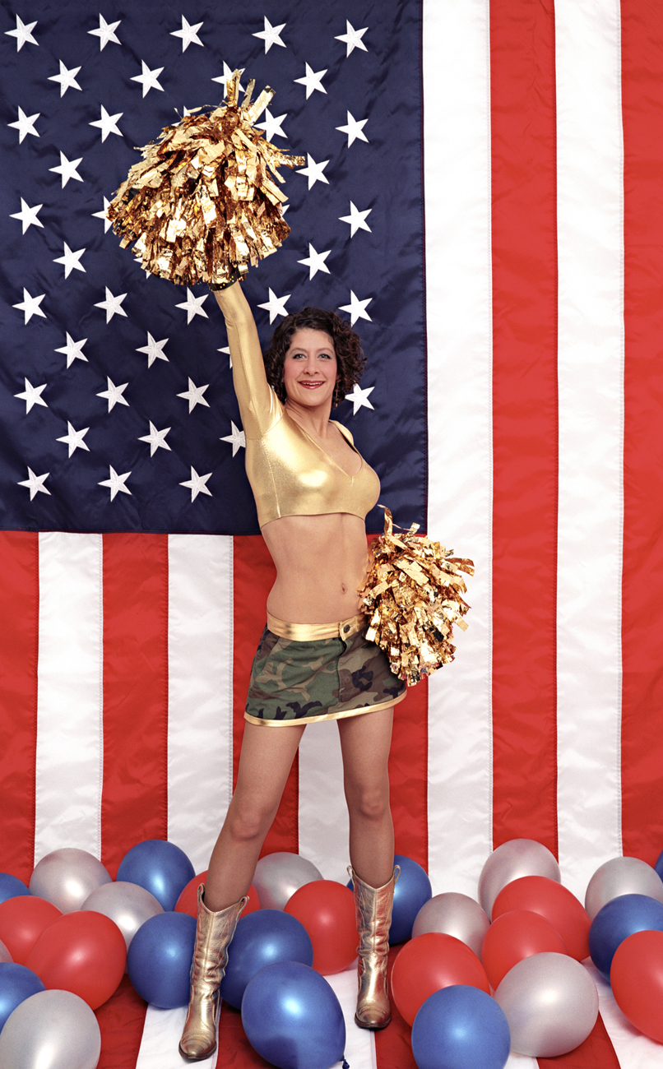
Patriot Act (2005)
Performance-based, self-portrait image

Slide 7
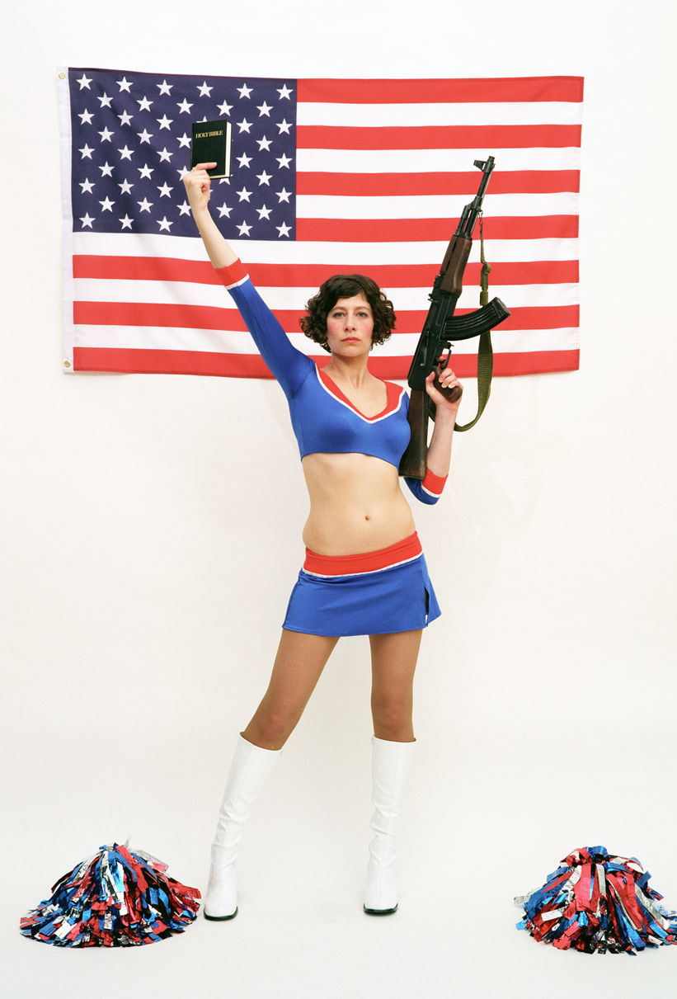
From the diptych Patriot Acts (2006)
Performance-based, self-portrait image

Slide 8
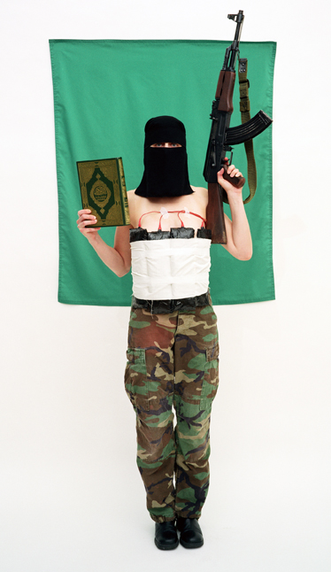
From the diptych Patriot Acts (2006)
Performance-based, self-portrait image

Slide 9
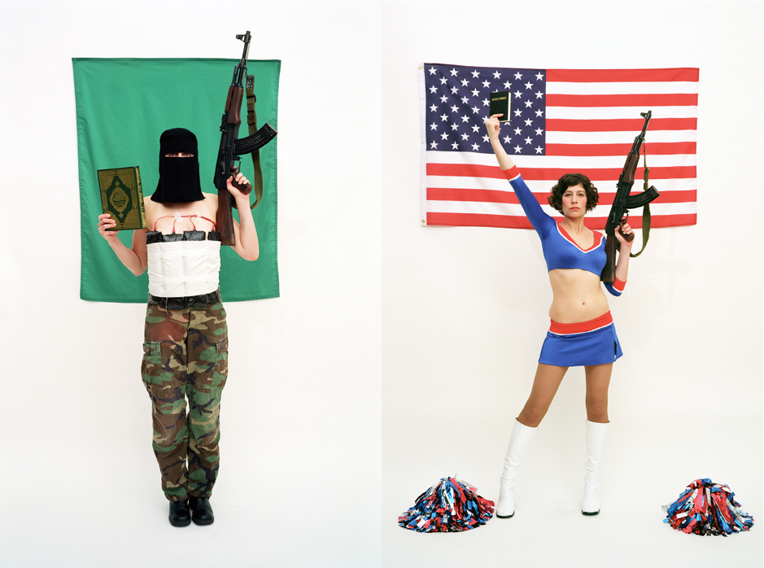
Patriot Acts (diptych 2006)
Performance-based, self-portrait images

Slide 10
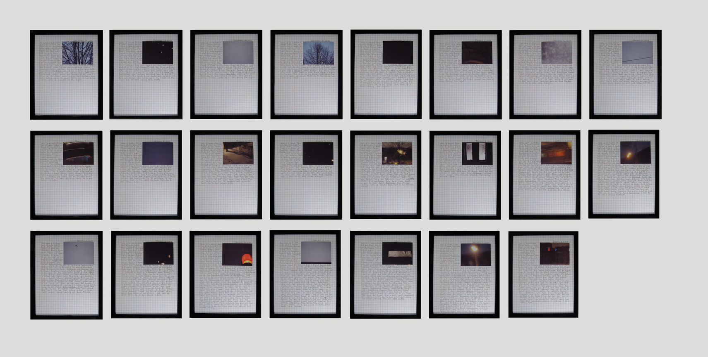
Concrete infinity Gaza Project (2009)
Wall installation, approximately 10 x 4 feet.
23 framed texts with photographs, one for every day of Operation Cast Lead, 12.27.08 – 1.18.09

Slide 11
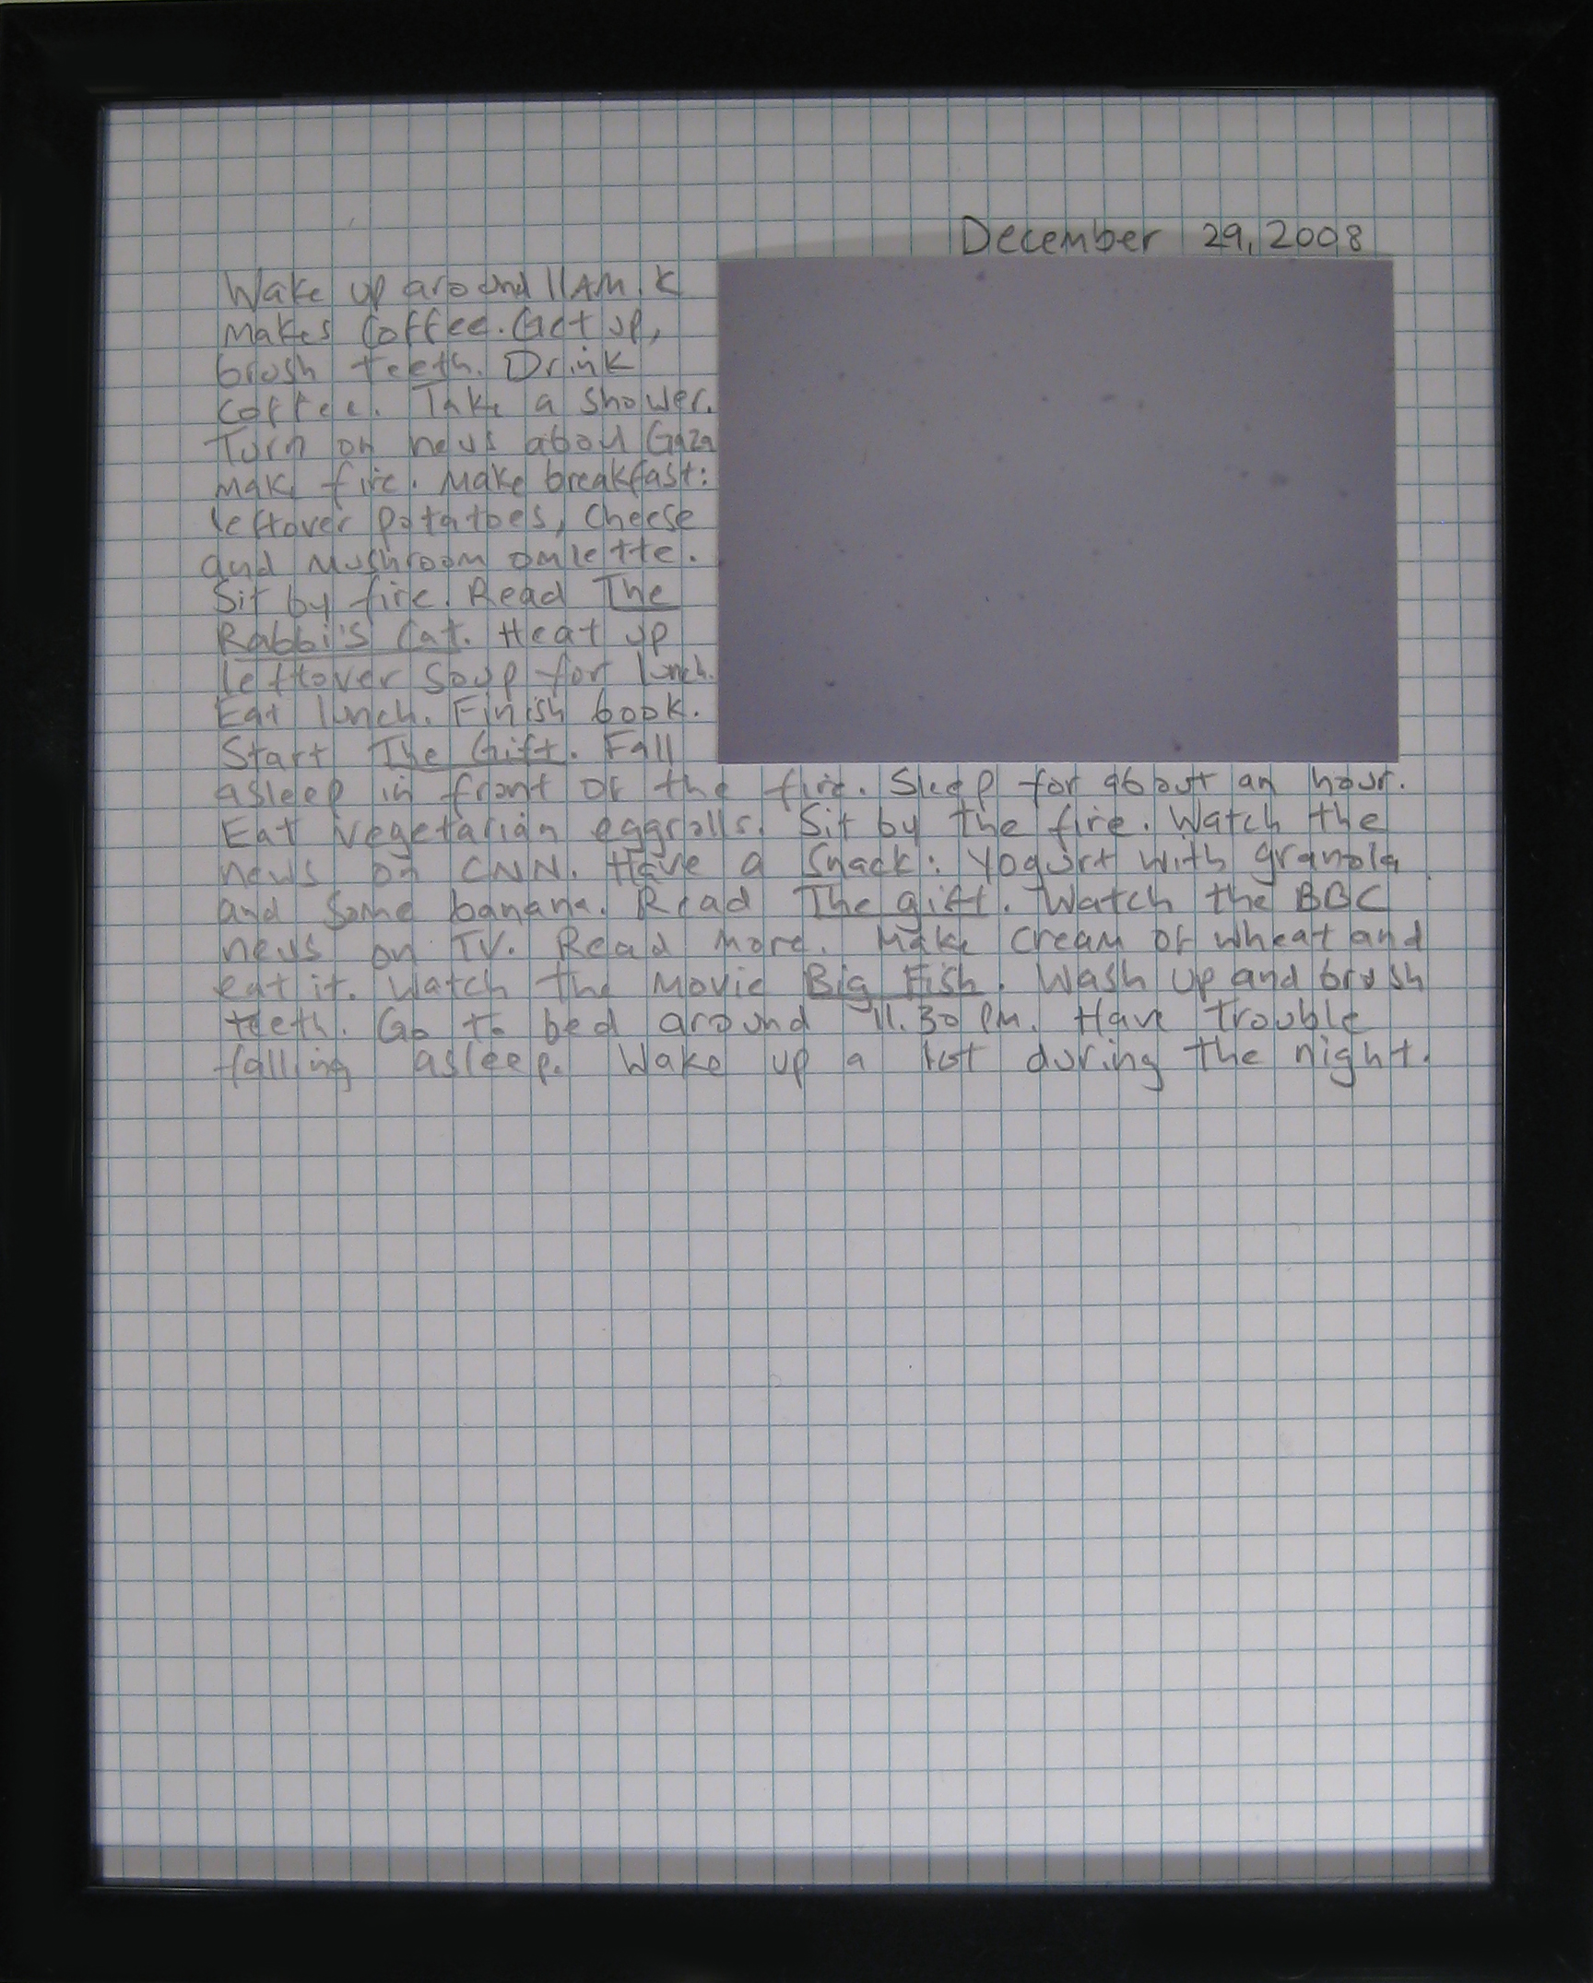
Concrete infinity Gaza Project (detail)
Text for December 29, 2009
(handwritten log of everything I did that day, with photograph)

Slide 12
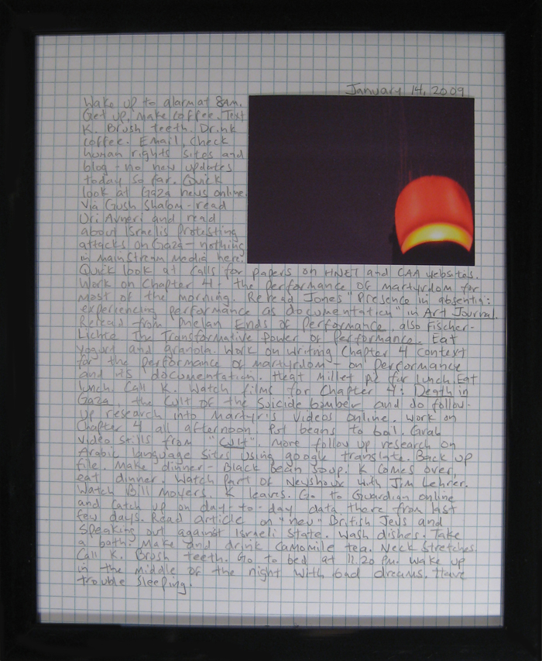
Concrete infinity Gaza Project (detail)
Text for January 14, 2009
(handwritten log of everything I did that day, with photograph)

Slide 13
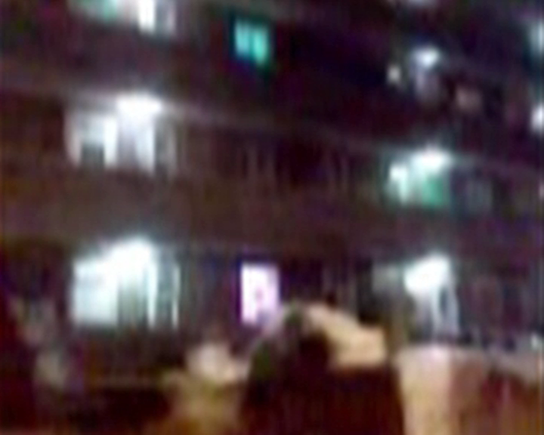
Blow Up
QuickTime movie – click image to play

