Slide 1
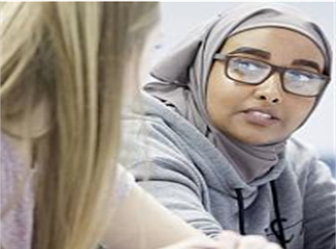
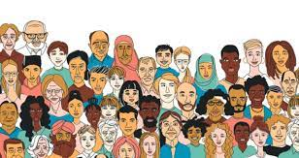
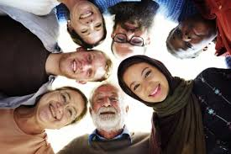
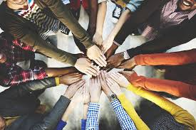
Do we really know who our students are? Understanding, implementing and embedding a culturally responsive pedagogy in our everyday practice Dr Aminul Hoque MBE Goldsmiths College, University of London

Slide 2
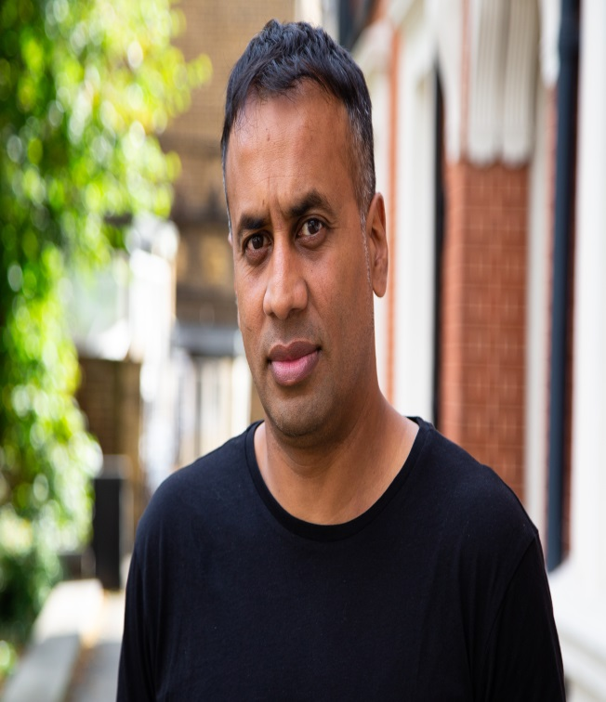
About me
Dr Aminul Hoque MBE, @BrIslam2015
Lecturer/ researcher in Education, Goldsmiths College
PhD – 2011
Key research interests: identity, youth cultures, multiculturalism, race, migration studies, Islamic feminism
Key publications: British-Islamic Identity: Third Generation Bangladeshis from East London (2015)
Presenter for A Very British History: British Bangladeshis, BBC4, Feb 2020
Londoner, dad, gardener, football-mad

Slide 3
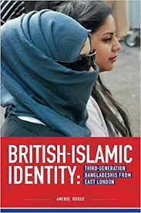
Structure of today’s talk/ workshop
Draw on my own ethnographic research with young Bangladeshis from London, current work with Goldsmiths’ students & my anti-racist work with the National Education Union (NEU)
Provide insight to some of the everyday ‘lived experiences’ of exclusion and alienation that many BAME students from disadvantaged backgrounds live through
I will argue that these areas of disparity and disadvantage have become even more problematic (and visible) during the Covid-19 pandemic
I will offer some practical ways that educators can ensure that such students remain engaged and enthused in their educational journeys (focus on HE)

Slide 4
Key questions
1. Do we really know who our students are? Do/ should we care?
2. Are we aware of the wider social, community and cultural issues that many of our students are living through?
3. How do we get to know our students and ensure that their views, interests, lived experiences, aspirations inform and guide our pedagogical practices?

Slide 5
No right or wrong answers…
What is teaching?
What is ‘education’?
HOW do we teach? (think about key skills, characteristics, support, infrastructure required for effective/ meaningful teaching)
Is there an ‘end’ goal for educators? If so, what is it?
Who are the key stakeholders in an individuals educational journey?

Slide 6
Educational/ Teaching Philosophy
John Dewey (1859-1952) – child-centred approach, focus on the ‘experience’ of children, connecting the wider socio-cultural world of the child with the classroom, making education meaningful.
Paulo Freire (1921-1997) – education as a dynamic, two-way, humanistic process, building positive relationships with people, understanding them, dialogue is important, raising the consciousness of people.
Antonio Gramsci (1891-1937) – challenging the wider social structure (status quo) through counter-hegemonic education, raising the social and moral consciousness in people, focus on social justice and equity.
bell hooks (1952-2021) – empowering students, education as a free space for exploring ideas, anyone can learn.
Bernard Crick (1929-2008) – purpose of education is to make people better ‘citizens’.
Rabindranath Tagore (1861-1941) – education is about expression, creativity & self-realization.
Frank Furedi (1947 - present) – ‘politics’ should be left out of education. Teachers should just ‘teach’!

Slide 7
Culturally responsive pedagogy
In light of neoliberal reforms to education, there is a need to revert back to a more inclusive and collaborative form of education where the line between the school and the community is blurred and where the complex cultural, linguistic, ethnic, gender and religious identities of our pupils are explored within the curriculum. As a teaching philosophy, a culturally responsive pedagogy is premised on the idea that valuing culture is central to learning. Educators cannot trivialise or pay token attention to the cultural world and lived experiences of their pupils, and instead take time to understand their pupils and their sociocultural worlds, listen to them as well as valuing and maintaining their cultural identities and heritage within pedagogical practices. Such an approach empowers pupils intellectually, socially, emotionally and politically (Hoque, 2015b, 2018; Lucas and Villegas 2013; Nieto 2000).

Slide 8
Students/ pupils/ young people do not leave their sociocultural worlds and identities behind once they enter the school gates – and nor should they!
(Bullock Report, 1975)

Slide 9
‘Decolonising’ education
‘A decolonial culturally responsive pedagogy not only foregrounds students’ social and cultural backgrounds, but criticises the dominant knowledge that shape mainstream educational learning contexts’
(Hickey-Moody & Horn, 2022: 5)

Slide 10
‘Ideal’ univeristy student – key characteristics/ background required
(relative) financial stability. Flexibility. Access to networks of ‘critical’ friends. Literate (‘professional’) parents/ siblings. Access to stationery/ digital equipment/ wi-fi/ homework space etc. Confidence to ask questions. Knowledge of the university (HE) system. Ability to read CRITICALLY. Career plan? Time (to ‘hang out’ at university and not always rushing to get home; to do my reading and not feel ‘tired’ all the time). Not having to work (help family, pay for mobile bills/ travel). Well travelled (‘worldly’). Independent study skills.

Slide 11
Case study – Fatima, aged 19, female, Bangladeshi, from London. Wants to become a teacher. ‘My typical week’.
I love my family and my very close-knit Bangladeshi community. My culture and community mean a great deal to me, although it can be sometimes overwhelming – the private is nearly always public. I have a large family. I am the second oldest of 5 siblings, and also the first person to go university (a great source of pride for my family). So the pressure is on! My parents are amazing and super-supportive, but are always busy managing the house. My father grew up in Bangladesh and cannot speak much English. He is always working all sorts of hours in a grocery store. My mum is a housewife and also has a disability which means that my older sister and I have to help out a lot at home. It is chaotic at home, but I love it. I share a room with 2 of my sisters, and we are constantly fighting for the one working laptop that we have. My grandparents also live with us and frequently I have to take them for hospital appointments because I can speak English. And often, either myself or my older sister have to drop my younger siblings off to school and pick them up. My day starts at 6.30am because I have to get them ready for school and then rush to university to make the 10am lecture. And then I’m rushing back afterwards for the pick up. Oh did I also tell you that I am online for Arabic classes everyday between 5-7pm, and I have a part-time weekend job. I am always ‘running’ and ‘juggling’. ‘Multitasking’ has become part of my identity.

Slide 12
What barriers/ challenges/ opportunities can you identify?

Slide 13
The intersectional ‘lived experiences’ of many students from BAME backgrounds
These pupils also happen to come from low income socio-economic backgrounds and also have been disproportionately affected (recently) by the Covid-19 pandemic.
The wider empirical research highlights that many of these students have an intersectional lived experience focused around cultural barriers to higher education, part time employment commitments, care responsibilities, apathy towards wider university social education, poverty of (low) aspirations (Archer et al, 2010; Hoque, 2015a, 2018).
These students are also overwhelmingly of Muslim/ Islamic background and there is an additional institutional and societal barrier of discrimination (Islamophobia) that they need to negotiate? (Allen, 2010; Shain, 2003, 2010; Hoque, 2015a, 2018).

Slide 14
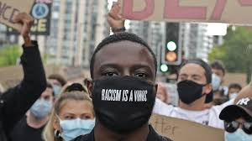
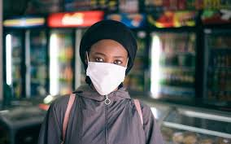
Covid-19 – a working class reality
Intergenerational households
Overcrowded houses
Digital poverty
Caring responsibilities (cultural)
Service sector employment (‘too nice & compliant’)
Mistrust in the health service (‘institutionalised’ racism) -Discrimination
Underlying health issues?
Mental health

Slide 15
A culturally inclusive pedagogy: Some practical suggestions
There must be ‘buy in’ from management/ hierarchy.
Get to know your students. Listen and talk to your pupils. Give them space to tell you ‘their’ stories.
Activities, readings, sports, curriculum, discussions to reflect diverse student population.
Continuous staff training.
Take a ‘walk’ in the community (events, read local papers, gov data, etc).
As a teacher, if you don’t understand something about your pupils, ask them to tell you about it! Be non-judgemental and don’t just fall back on your own prejudices and bias. Take a reflexive approach.
Encourage parental/ family/ community engagement in the child’s learning.
Make the ‘national’ curriculum a ‘relevant’ one.

Slide 16
The debate continues……. Stay in touch Dr Aminul Hoque Department of Educational Studies Goldsmiths, University of London E: a.hoque@gold.ac.uk Twitter: @BrIslam2015

Slide 17
Questions?

Slide 18
References
Allen, C (2010) Islamophobia, Farnham: Ashgate
Archer, L., Hollingworth, S., & Mendick, H (2010) Urban Youth and Schooling, Maidenhead: Open University Press
Bullock, A (1975) A Language for life. The Bullock Report. London: Her Majesty’s Stationery Office.
Hickey-Moody, A & Horn, C (2022) ‘Family stories as resources for a decolonial culturally responsive pedagogy’, Discourse: Studies in the Cultural Politics of Education, DOI: 10.1080/01596306.2022.2062834
Hoque, A (2020) ‘Research to reflect on: developing a culturally responsive pedagogy’. National Education Union NEU. https://neu.org.uk/media/11431/view
Hoque, A & Keelan, A (2020) A Very British History: British Bangladeshis. BBC4, Jan 2020.
Hoque, A (2018) ‘Third-generation British-Bangladeshis from east London: complex identities and a culturally responsive pedagogy’, British Journal of Sociology of Education, 39:2, 182-196, DOI: 10.1080/01425692.2017.1406335
Hoque, A (2015a) British-Islamic Identity: Third-Generation Bangladeshis from East London, London: IOE/ Trentham Press
Hoque, A (2015b) ‘Knowing our students’ identities: British Bangladeshis in east London schools’. Race Equality Teaching 33(1): 16-21
Lucas, T., and A. M. Villegas (2013) ‘Preparing Linguistically Responsive Teachers: Laying the Foundations in Preservice Teacher Education’, Theory into Practice 52: 98–109.
Nieto, S. (2000) ‘Placing Equity Front and Center: Some Thoughts on Transforming Teacher Education for a New Century’, Journal of Teacher Education 51: 180–18
Shain, F (2010) The New Folk Devils: Muslim Boys and Education in England, Stoke-on-Trent: Trentham Books
Shain, F (2003) The schooling and identity of Asian girls, Stoke-on-Trent: Trentham Books

