Slide 1
Aminul Hoque

Slide 2
Immigrant, social pedagogue, BBC journalist, Islamic expert, consultant, community activist, sociologist, teacher, brother, broadcaster, anthropologist, youth worker, citizen, philosopher, son, uncle, ‘black’, British, Bangladeshi, Sylheti, Londoner, Eastender, Aminul, public intellectual, son-in-law, academic, ethnographer, lecturer, author, father, educator, critical thinker, researcher, footballer, gardener, feminist, ‘big kid’, friend, ‘Dr’, Man United fan, husband…

Slide 3
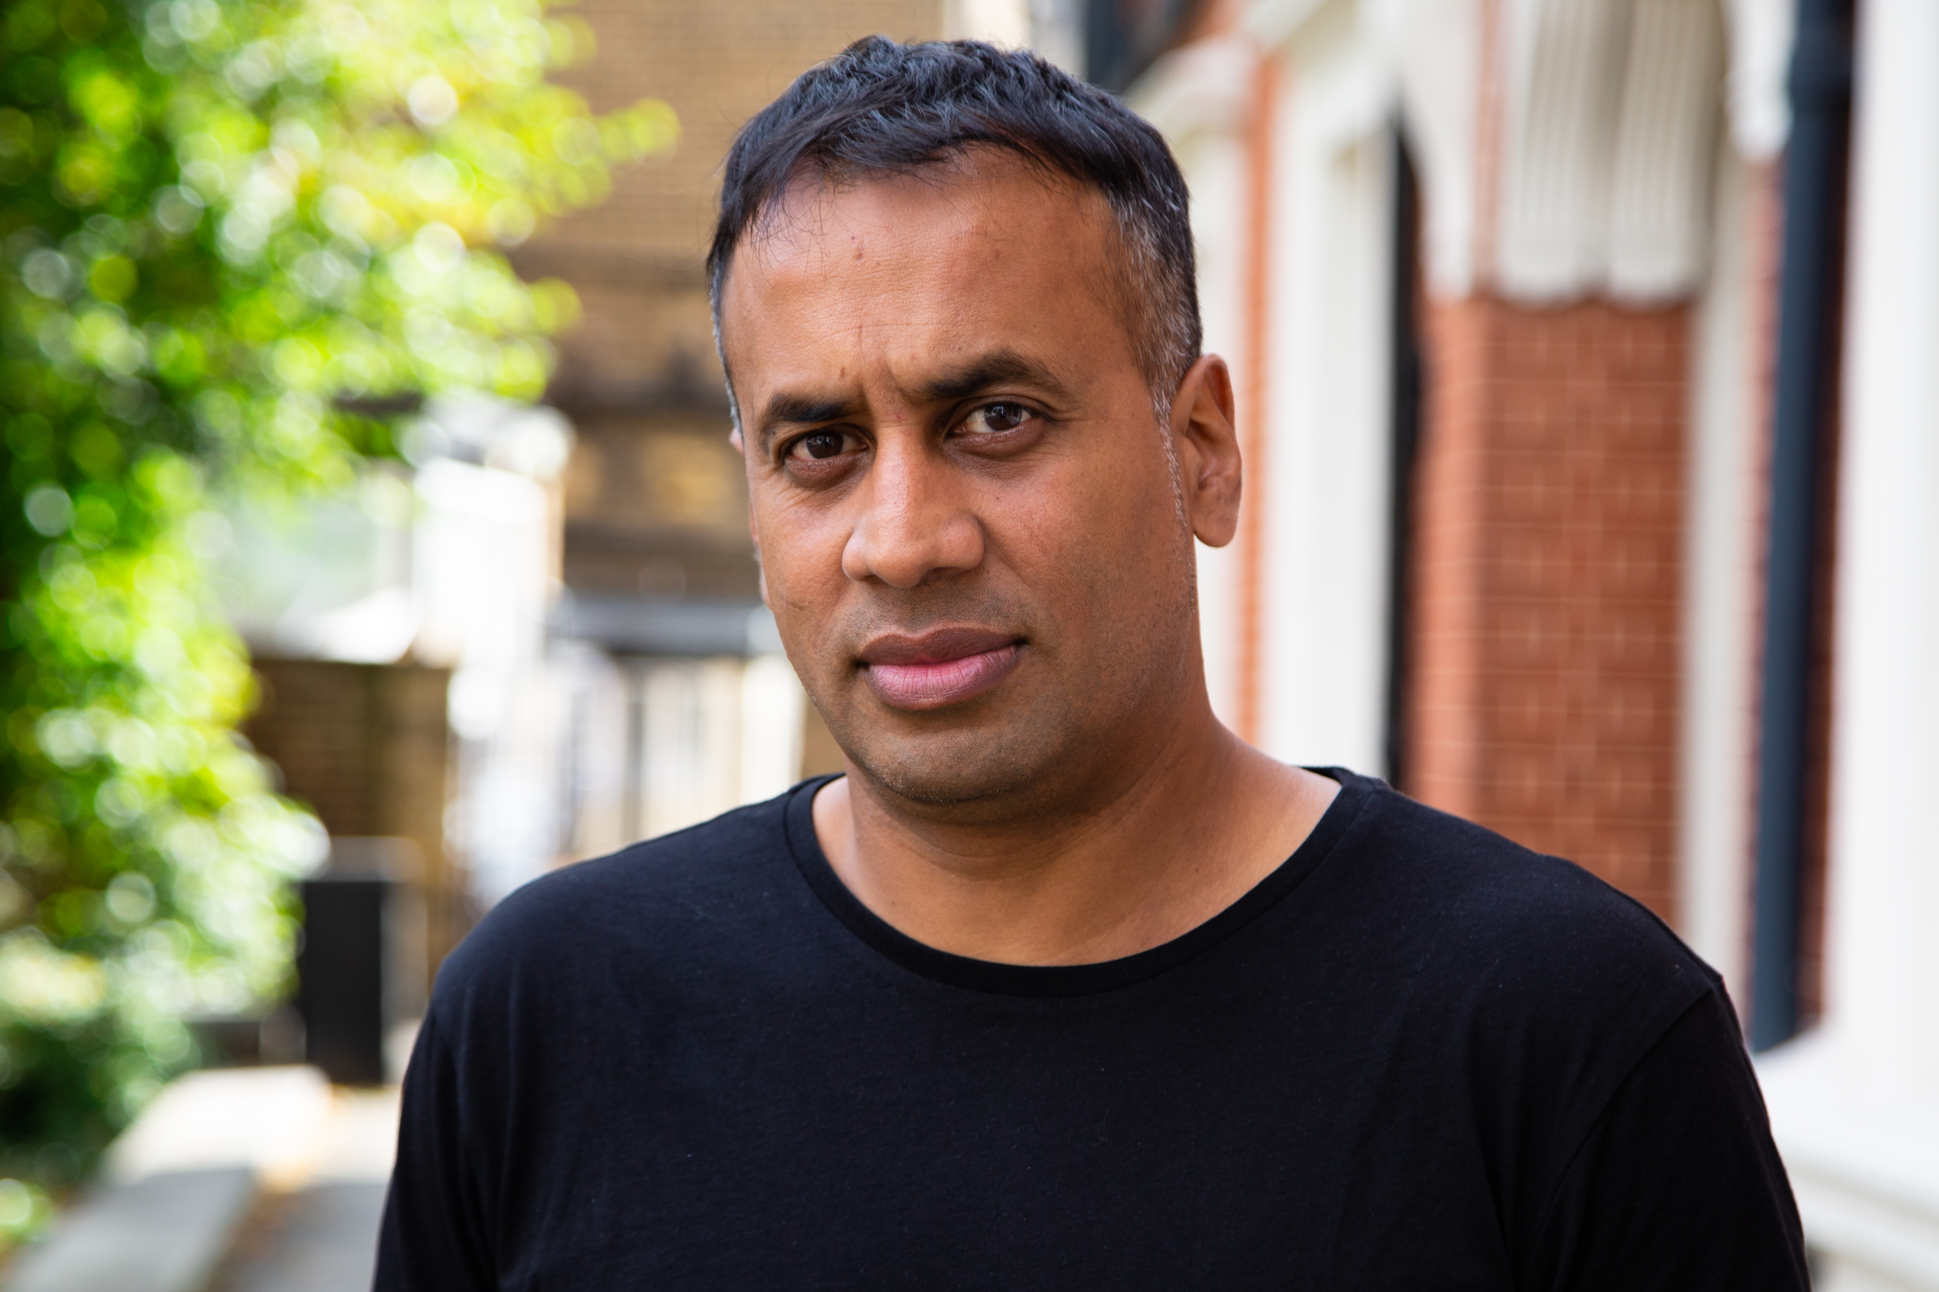
About me
Dr Aminul Hoque MBE, @BrIslam2015
Academic/ writer/ author/ broadcaster/ journalist
Lecturer/ researcher in Education, Goldsmiths College
PhD – 2011
Key research interests: identity, youth cultures, multiculturalism, race, migration studies, Islamic feminism
Key publications: British-Islamic Identity: Third Generation Bangladeshis from East London (2015)
Presenter for A Very British History: British Bangladeshis, BBC4, Feb 2020
Londoner, dad, gardener, football-mad

Slide 4
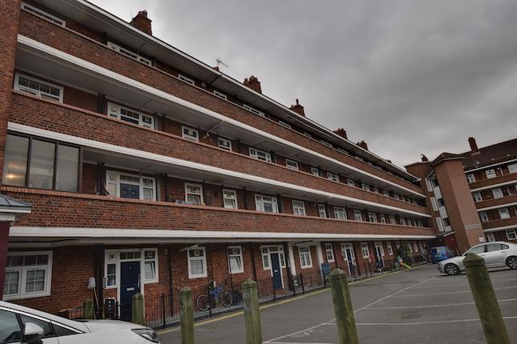
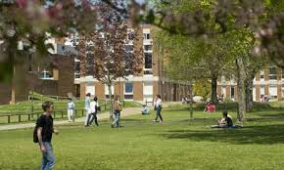
Estate life
Mudhut
Intrepid traveller
'
‘white’
Sussex
Suburbia

Slide 5
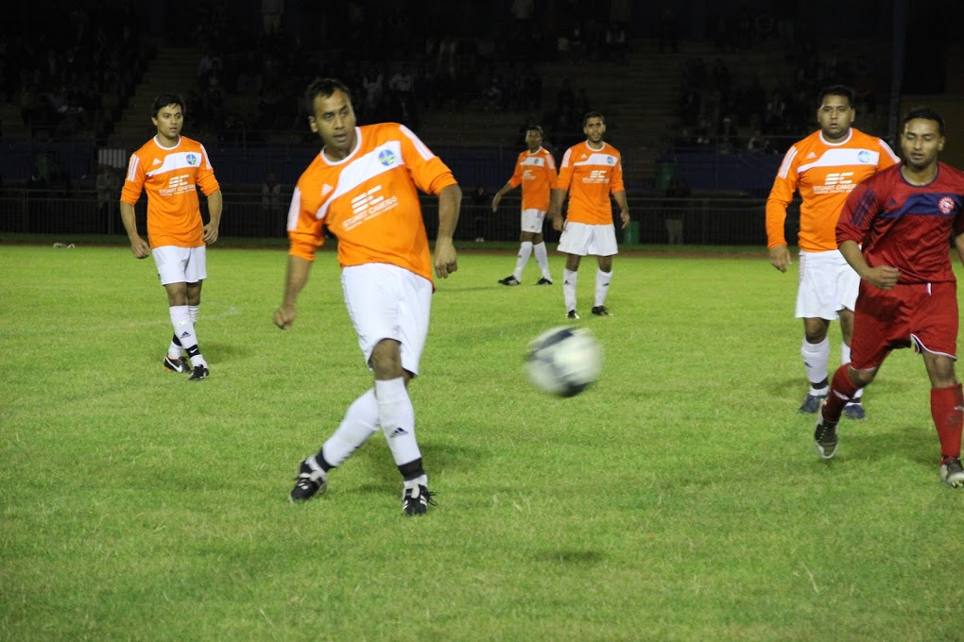
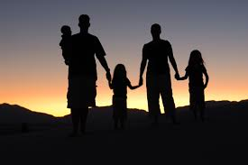
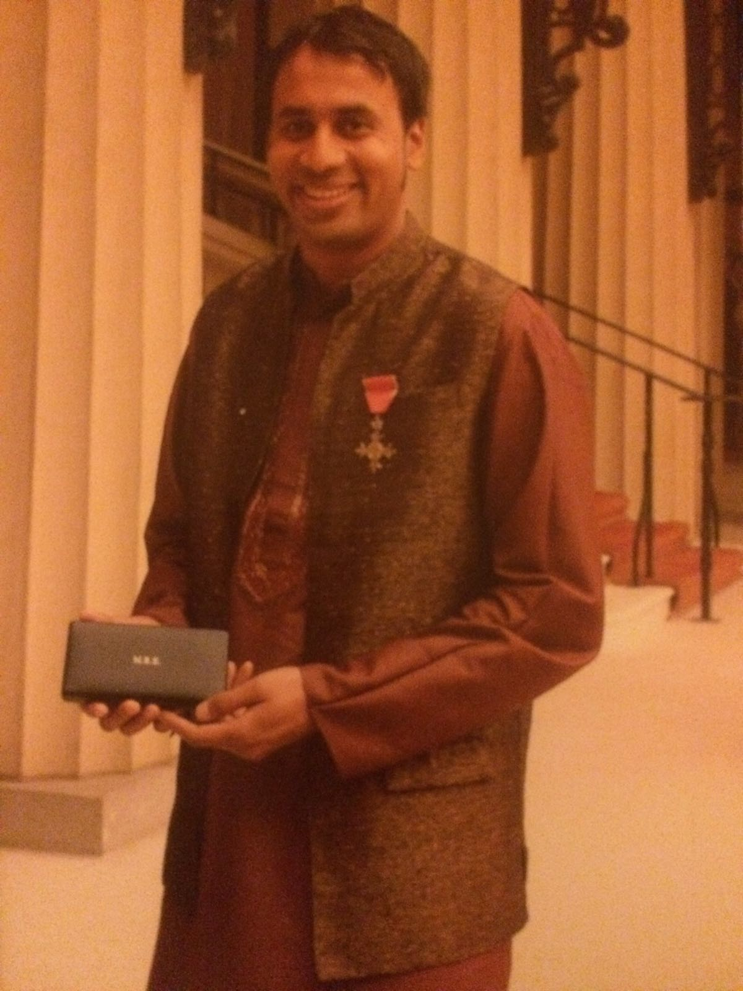

Slide 6
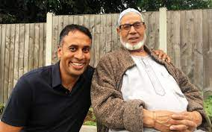
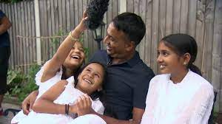
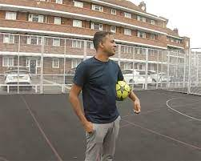
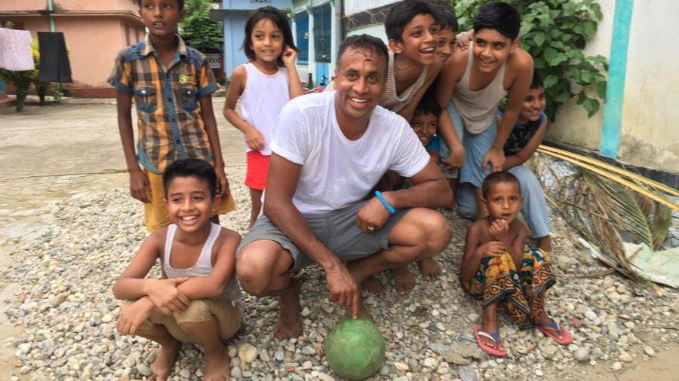
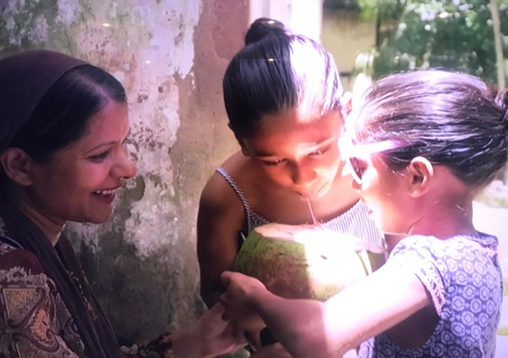
A Very British History: British Bangladeshis, BBC4, Feb 2020
https://www.bbc.co.uk/programmes/p082bnt8
https://vimeo.com/460112894/51e1267652
Searching for Secrets: London, Smithsonian Channel, June 2021

Slide 7
The hidden stories from the seamstresses
Meeting and conversing with so many community heroes and inspirational role models
Relevant also in this current geo-politics of heightened xenophobia, rise of populist nationalism and a climate of hate towards minority communities, as it highlights that migrant (Bangladeshi) communities are just normal, hard-working folk and have hopes, desires, anxieties and aspirations - just like everyone else! #BLM
Important that we don’t forget the stories and also capture these stories of our forefathers/ ancestors. The doc provided a space to my father to tell his story and then being able to retell this story to a mass audience
Has brought positive attention to our wonderful brilliant Bangladeshi community
Has started many household conversations
Going back to the country of my birth with my own children, and then hearing about their reflections and experiences
#Emotional

Slide 8
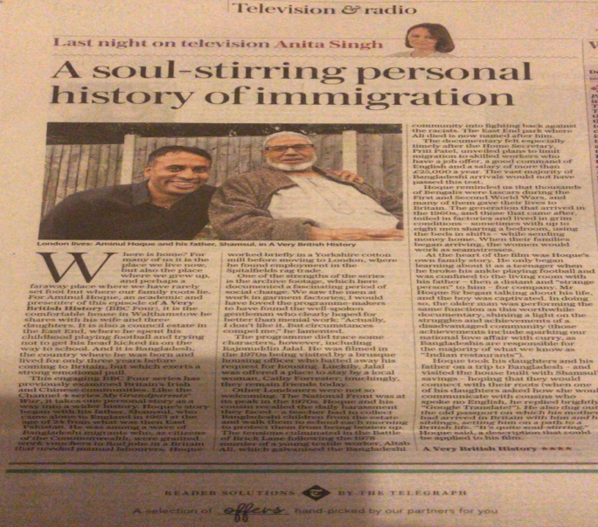
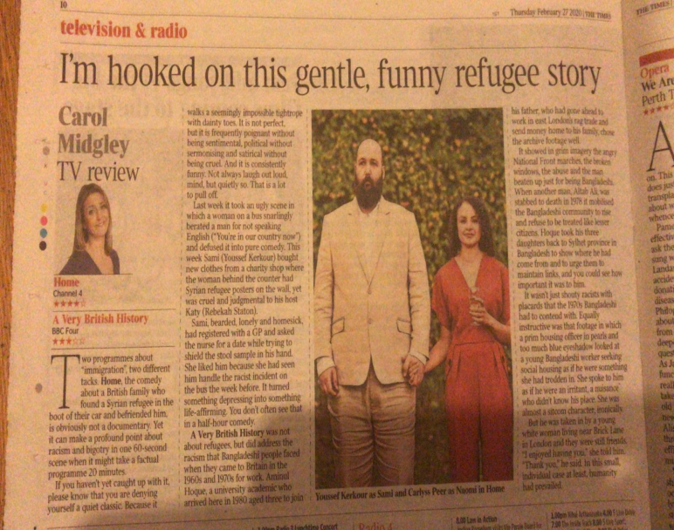
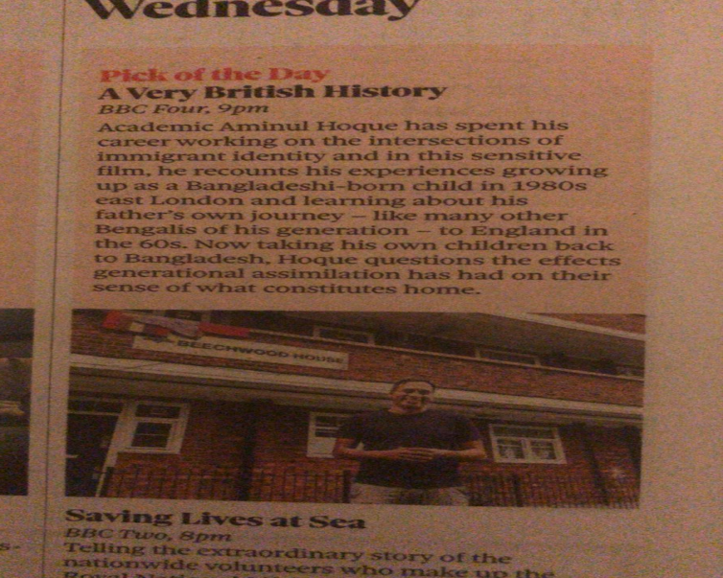
Critical response and reception
Social media was ‘buzzing’
Lots of emails/ letters from people sharing their personal stories of migration
‘Pick of the day’ @Telegraph, @guardian, @thetimes
‘Critic’s choice’ @theipaper
‘Soul-stirring’ @Telegraph
‘

Slide 9
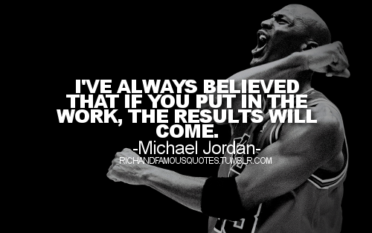
Books…
Literature….
Reading…
Travelling…

Slide 10
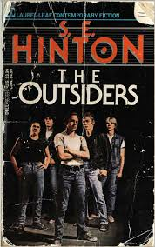
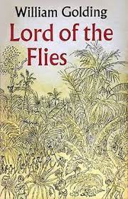
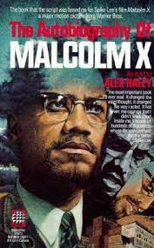

Slide 11
♯AskQuestions
♯Travel
♯BroadenYourHorizons
♯Watch&ReadTheNews
♯PositiveIdentity
♯Confidence
#The power of networking
♯Listen, be humble, reflect, learn

Slide 12
Good luck. All the best. Stay in touch E: a.hoque@gold.ac.uk Twitter: @BrIslam2015

Slide 13
Questions?

